Slide 1


Slide 2
Under The Guidance Of
Dr K Kamakshaiah
Done By
B Varshith Reddy 21R11A05B0 K Lekhya Manaswi 21R11A05C6
Neha Munuganti 21R11A05D7

Slide 3
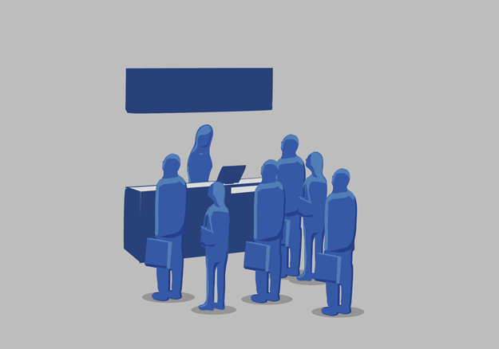
“With LIBRAREASE, there's no waiting for knowledge – discover, reserve, and borrow books instantly, right at your fingertips.”

Slide 4

1
ABSTRACT
2
OBJECTIVES
Contents
3
EXISTING SYSTEM
4
PROPOSED SYSTEM
5
TECHNOLOGY STACK
6
SYSTEM ARCHITECTURE
7
MODULES
8
INTERFACE DESIGN
9
CONCLUSION

Slide 5

ABSTRACT
LIBRAREASE is an innovative web-based library management system designed to simplify and enhance the library operations for both students and librarians. Built using HTML, CSS, PHP, JavaScript, and MySQL, the system enables users to efficiently manage book-related activities. Students can search, reserve, and view available books, while librarians can seamlessly manage book inventories, including adding, updating, and tracking borrowed or returned books. By automating and streamlining library processes, LIBRAREASE aims to reduce manual effort, enhance user experience, and improve overall library management efficiency.

Slide 6
OBJECTIVES
01
02
03
04
Develop a user-friendly digital library management system that allows students to efficiently search for, borrow, and access books from anywhere, providing real-time availability information.
Streamline and automate book management by reducing manual efforts in tracking and managing library resources, making operations smoother and more efficient.
Personalize the library experience for students by utilizing their profiles to offer tailored book suggestions and make borrowed books ready for pickup based on individual preferences.
Enhance overall library services through innovative solutions, contributing to better resource access, management, and user satisfaction.

Slide 7
OBJECTIVES
01
02
03
04
Develop a user-friendly digital library management system that allows students to efficiently search for, borrow, and access books from anywhere, providing real-time availability information.
Streamline and automate book management by reducing manual efforts in tracking and managing library resources, making operations smoother and more efficient.
Personalize the library experience for students by utilizing their profiles to offer tailored book suggestions and make borrowed books ready for pickup based on individual preferences.
Enhance overall library services through innovative solutions, contributing to better resource access, management, and user satisfaction.

Slide 8
OBJECTIVES
01
02
03
04
Develop a user-friendly digital library management system that allows students to efficiently search for, borrow, and access books from anywhere, providing real-time availability information.
Streamline and automate book management by reducing manual efforts in tracking and managing library resources, making operations smoother and more efficient.
Provide up-to-date information on book availability to keep students informed about which books are currently in the library and reduce the chance of requesting unavailable items.
Enhance overall library services through innovative solutions, contributing to better resource access, management, and user satisfaction.

Slide 9
OBJECTIVES
01
02
03
04
Develop a user-friendly digital library management system that allows students to efficiently search for, borrow, and access books from anywhere, providing real-time availability information.
Streamline and automate book management by reducing manual efforts in tracking and managing library resources, making operations smoother and more efficient.
Personalize the library experience for students by utilizing their profiles to offer tailored book suggestions and make borrowed books ready for pickup based on individual preferences.
Enhance overall library services through innovative solutions, contributing to better resource access, management, and user satisfaction.

Slide 10

Existing system
In the current manual library management system, students have limited means to search for books, often relying on physical card catalogs or rudimentary digital databases. Librarians manually update book counts and borrower records, leading to inefficiencies and potential errors. Overall, the existing system lacks automation and real-time data access, making book management cumbersome and prone to mistakes.

Slide 11


PROPOSED SYSTEM
The proposed system, LIBRAREASE, offers a streamlined and efficient approach to library management. Students will benefit from a user-friendly web interface where they can search for books, check availability, and submit borrowing requests online. Librarians will have access to administrative tools for adding, updating, and managing book inventory and borrower records with ease. The system will automate the tracking of borrowed books, handling return dates and borrower information while updating inventory in real-time. By reducing manual errors and simplifying processes, LIBRAREASE enhances both user experience and operational efficiency within the library.

Slide 12
IMPROVED ACCESSIBILITY
LIBRAREASE offers a user-friendly platform that allows students to search for books, check their availability, and request borrowing from anywhere, providing greater convenience and access to library resources.
EFFICIENT BOOK MANAGEMENT
Librarians can efficiently manage book records, update information, and track borrower details through the system, significantly reducing the time and effort required for manual tasks.
ADVANTAGES OF PROPOSED SYSTEM
REAL-TIME INVENTORY UPDATES
The system automatically tracks borrowed books and adjusts availability in real-time, ensuring accurate inventory management and reducing confusion over book availability.
REDUCED HUMAN ERROR
By automating the tracking of borrowed and returned books, LIBRAREASE minimizes manual errors, ensuring accurate record-keeping and a more reliable library management process.

Slide 13
User Interface Technologies
HTML, CSS, JavaScript
Backend Processing
PHP
TECHNOLOGY
Database Management
MySQL
STACK
Hosting And Server
XAMPP
Development Environment
VSCode

Slide 14











SYSTEM ARCHITECTURE
Index
Librarian
Student
Login
Login
Registration
Add Book
Borrow Records
Update Records
Search Books
View Books
Reserve
Books

Slide 15



Log In
Add Books
Update Books
Manage Borrow/Return
View Suggestions
Register/Log In
Search for Books
Reserve Books
View History
Post Suggestions
+
Book Information
Student Data
Borrow and Return
Books History
Suggestions
STUDENT MODULE
LIBRAREASE MODULES
LIBRARIAN MODULE
DATABASE MODULE

Slide 16
Log In
Add Books
Update Books
Manage Borrow/Return
View Suggestions
Register/Log In
Search for Books
Reserve Books
View History
Post Suggestions
+
Book Information
Student Data
Borrow and Return
Books History
Suggestions

Slide 17














INTERFACE DESIGN

Slide 18


Slide 19
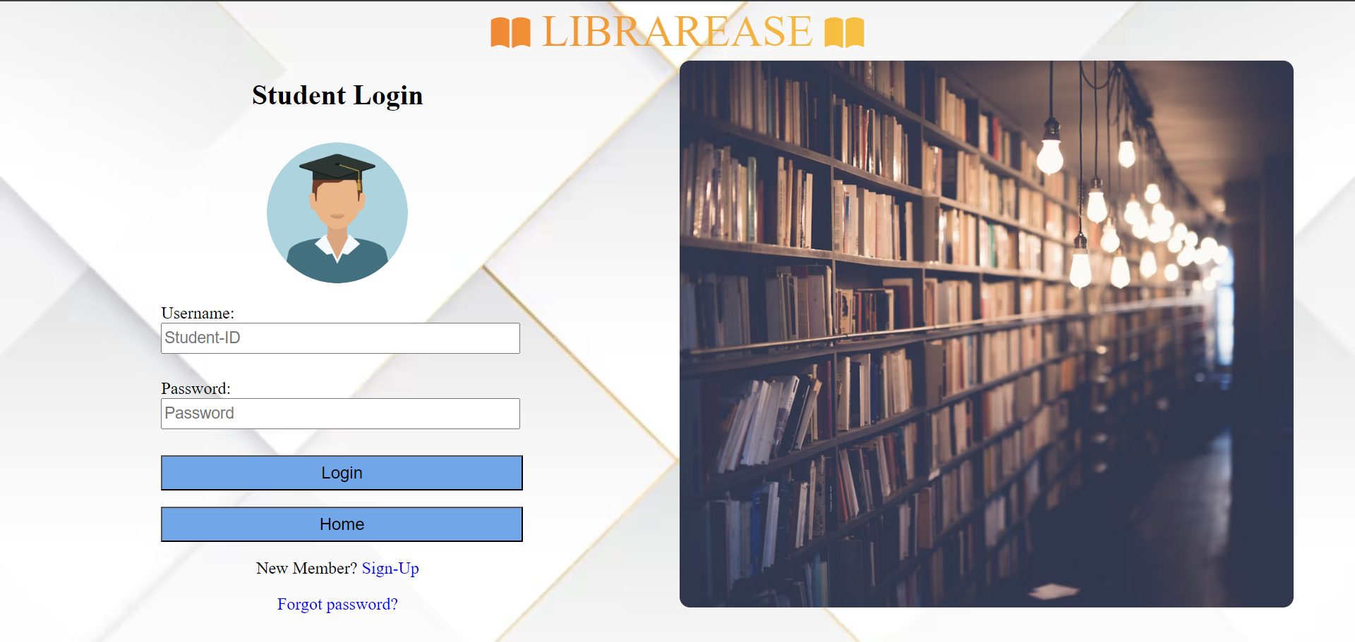

Slide 20
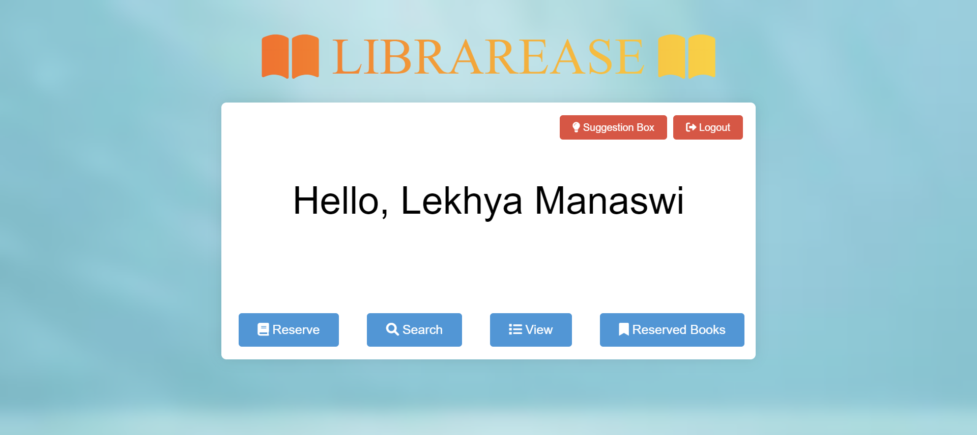

Slide 21
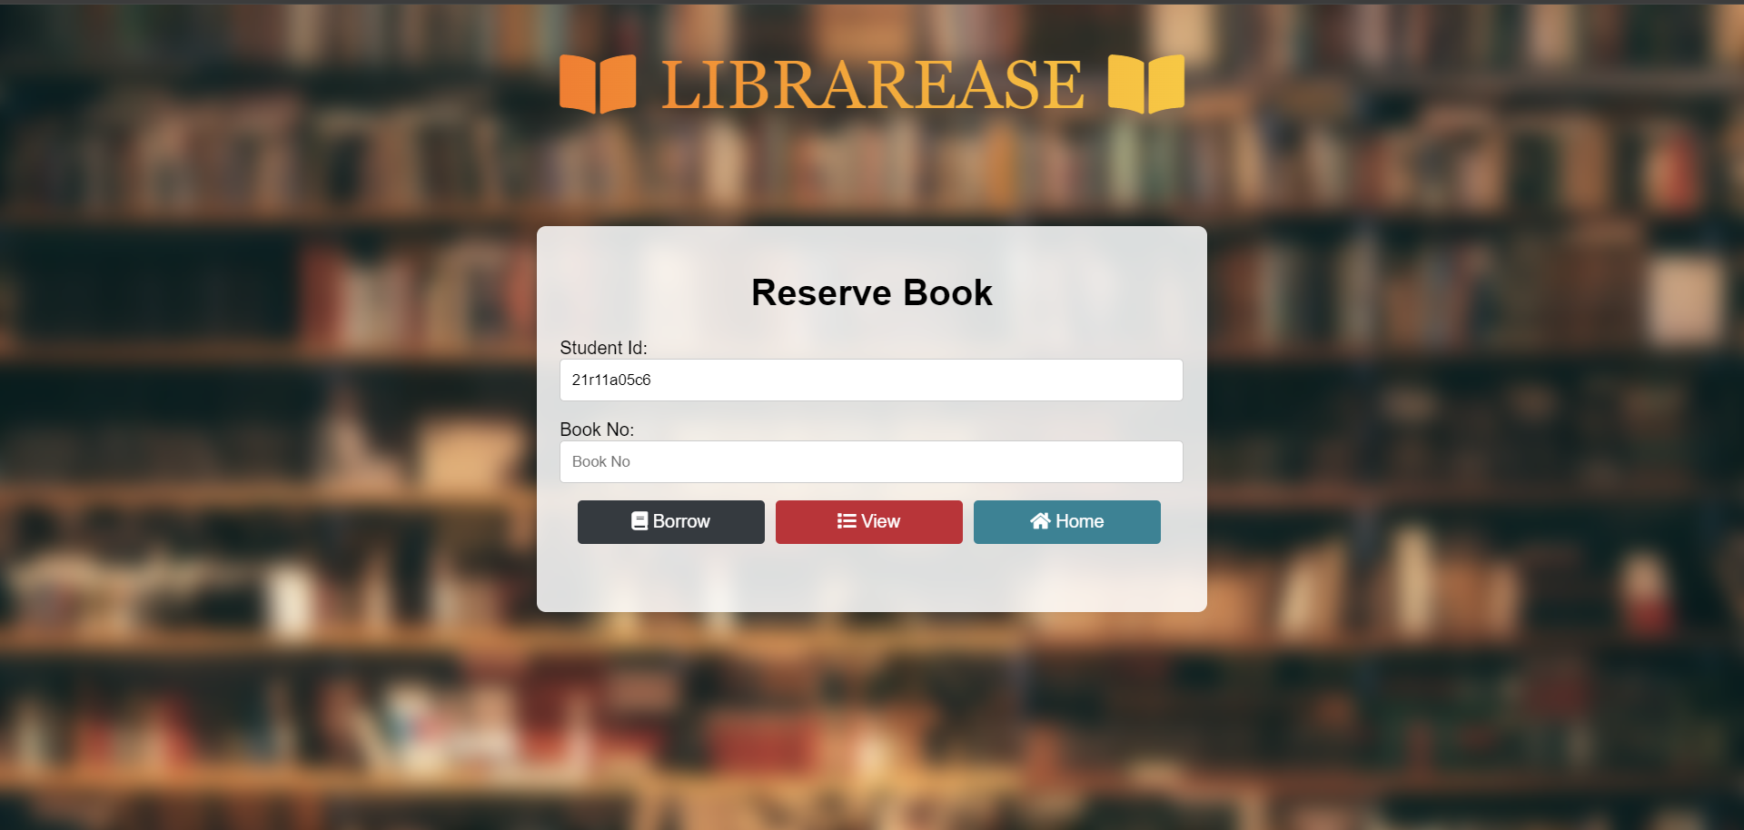

Slide 22
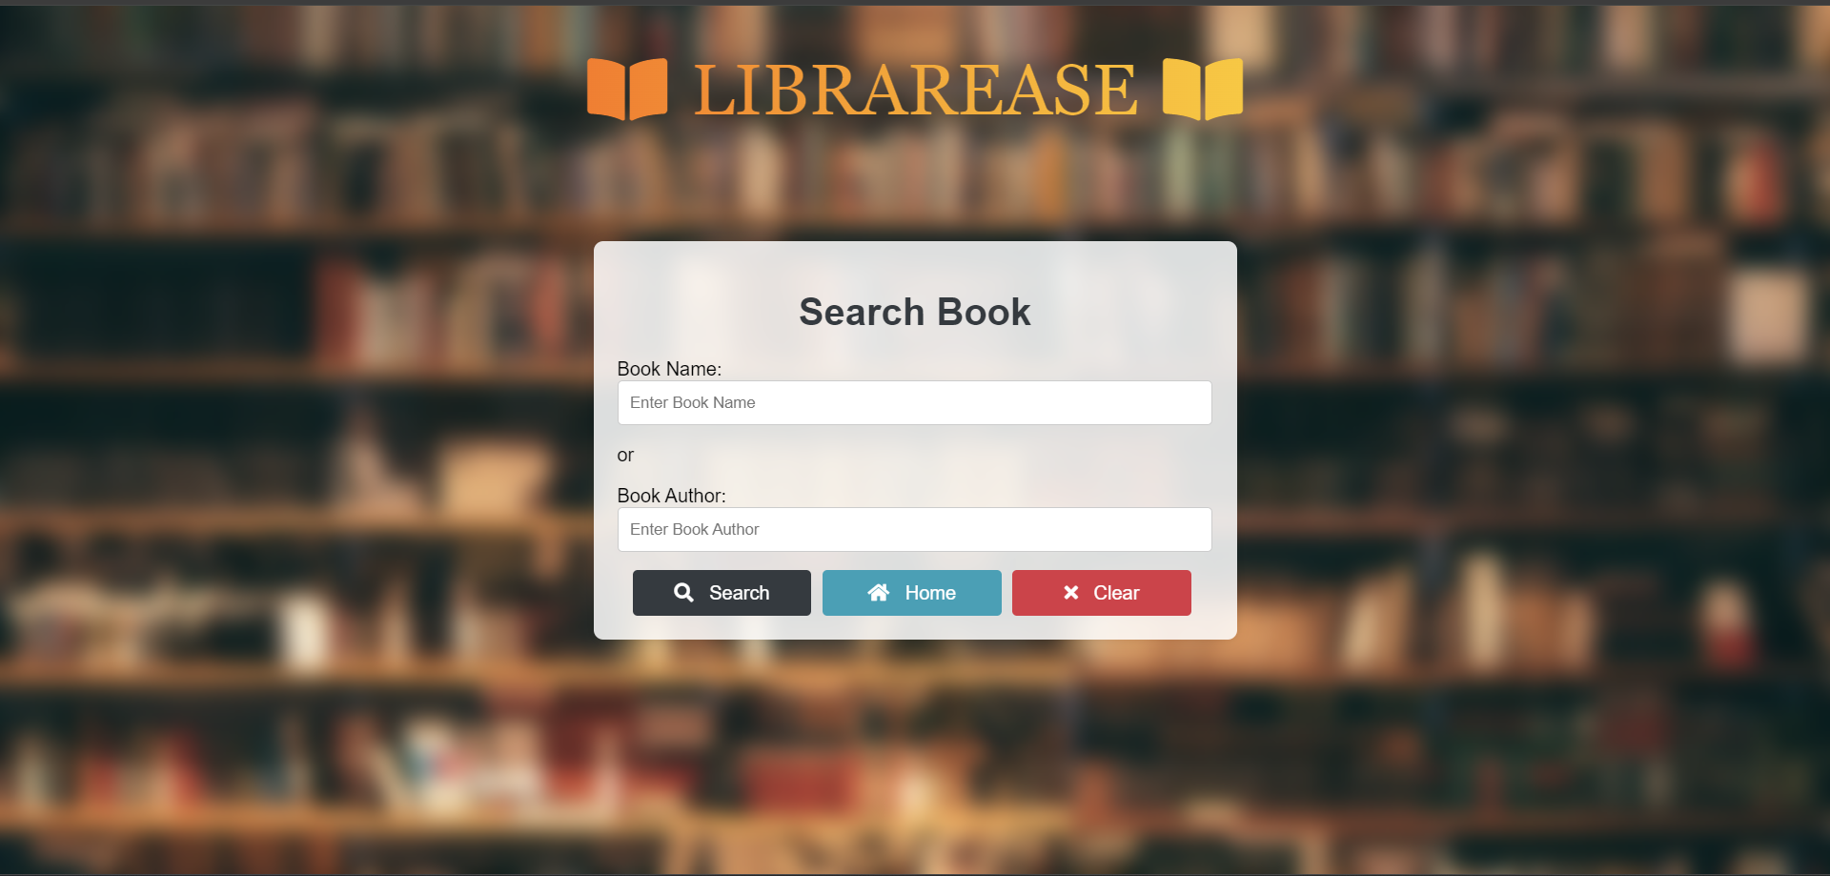

Slide 23
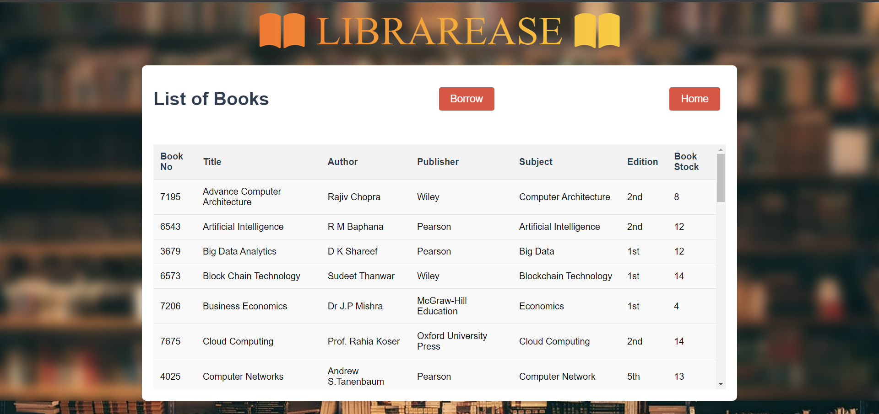

Slide 24
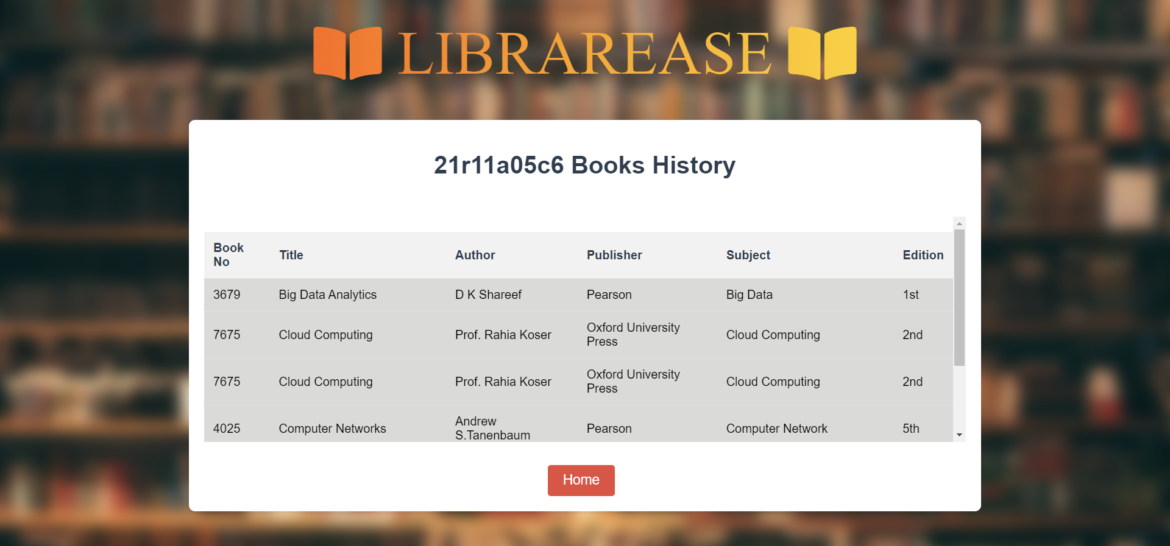

Slide 25
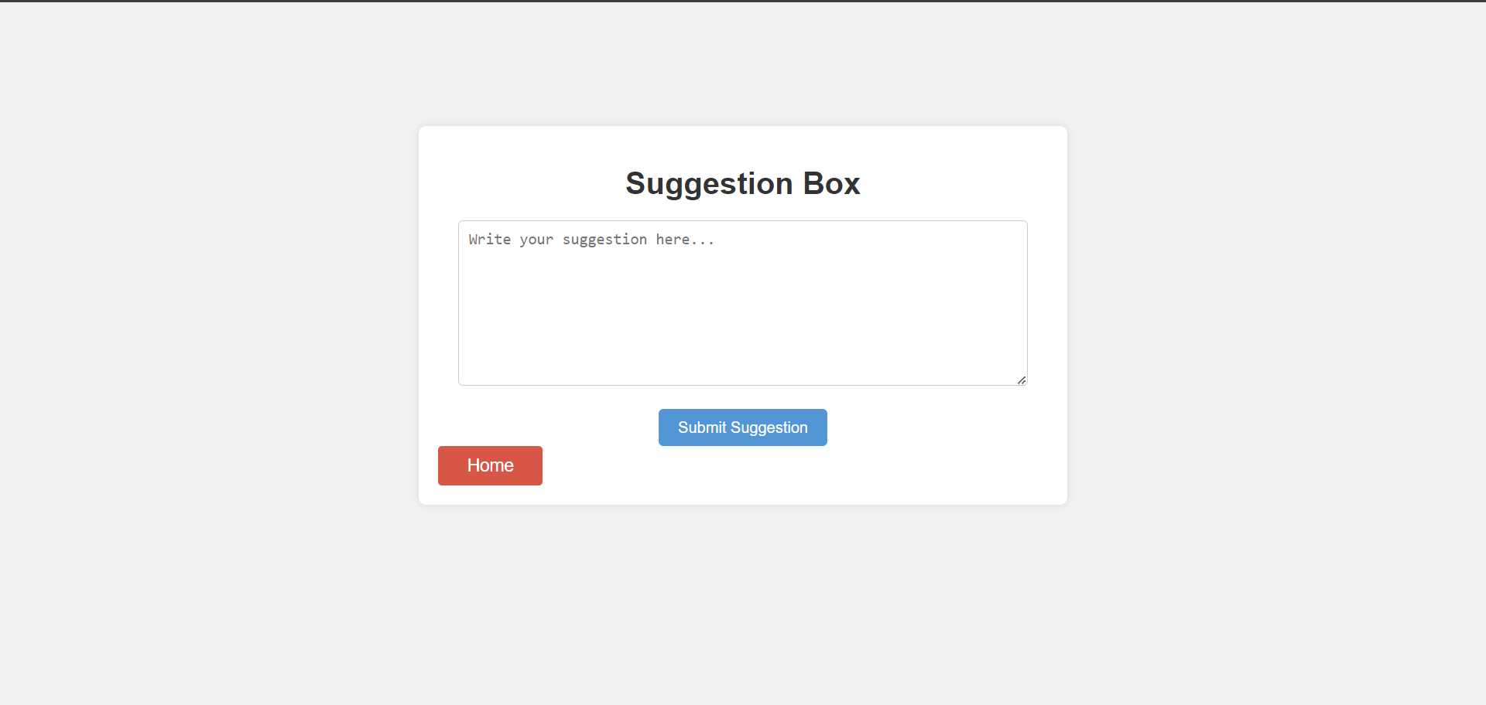

Slide 26
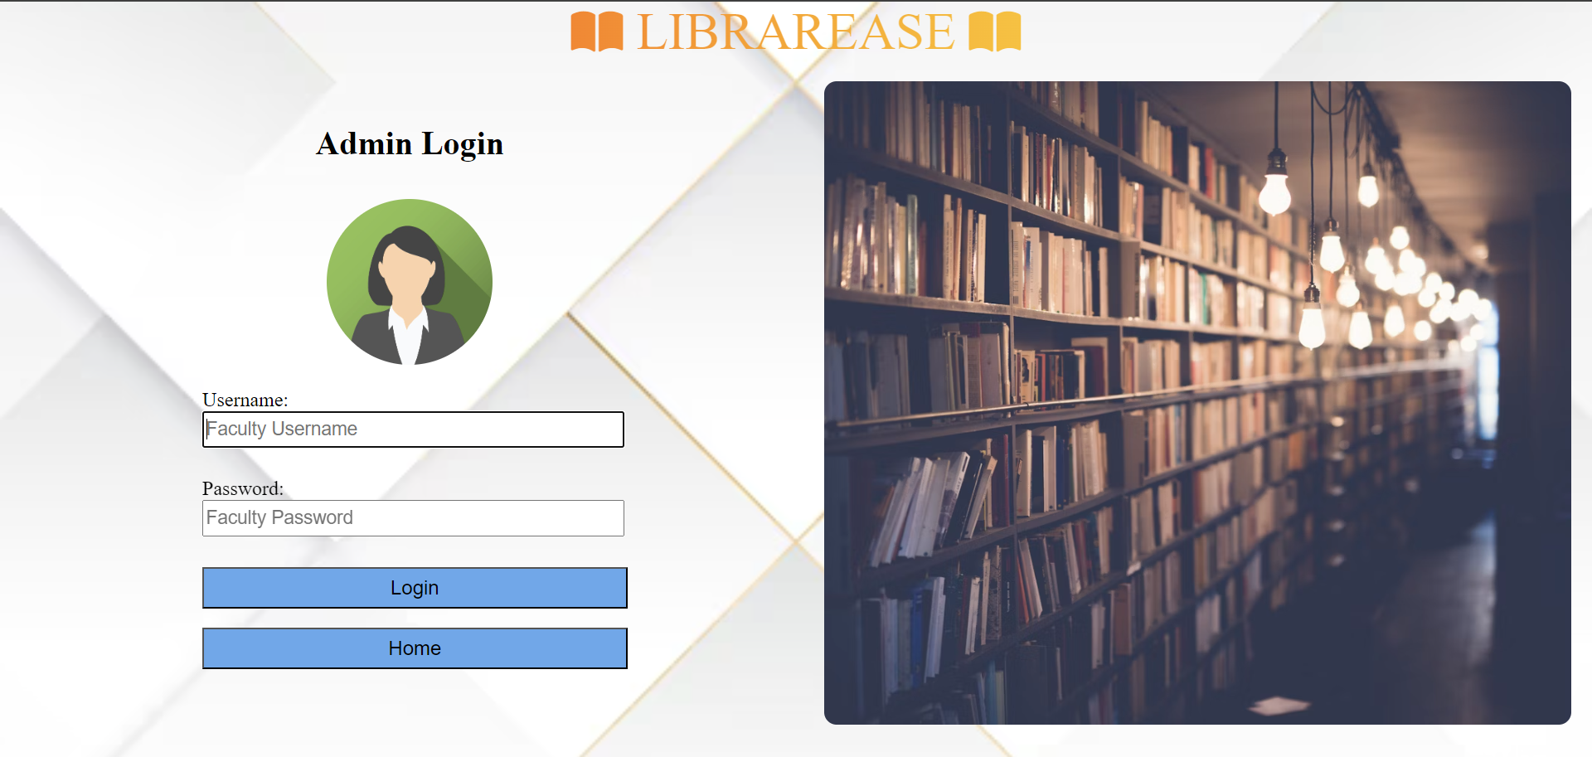

Slide 27
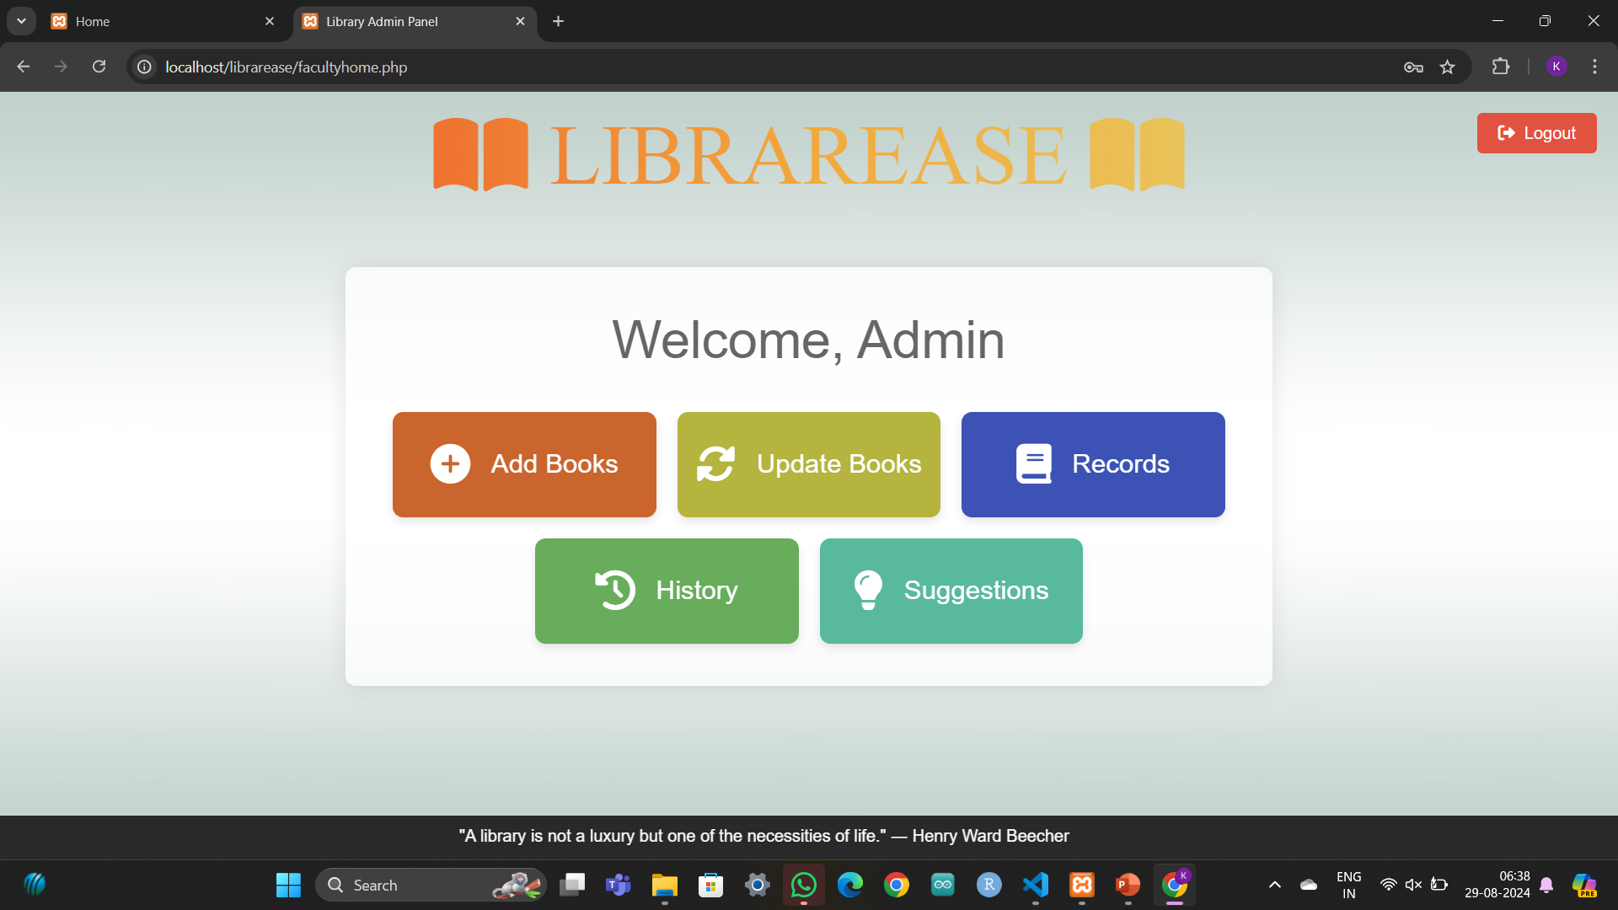

Slide 28
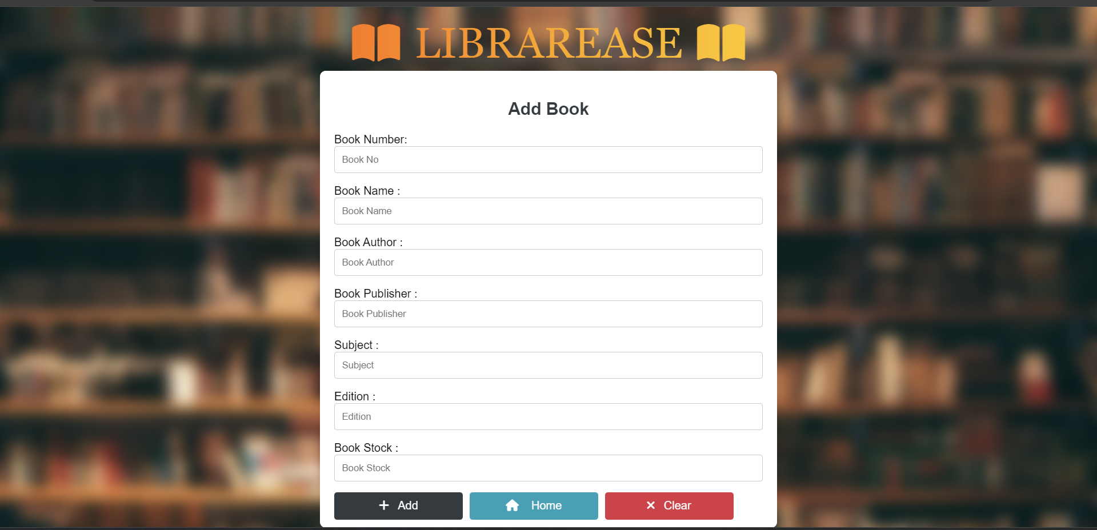

Slide 29
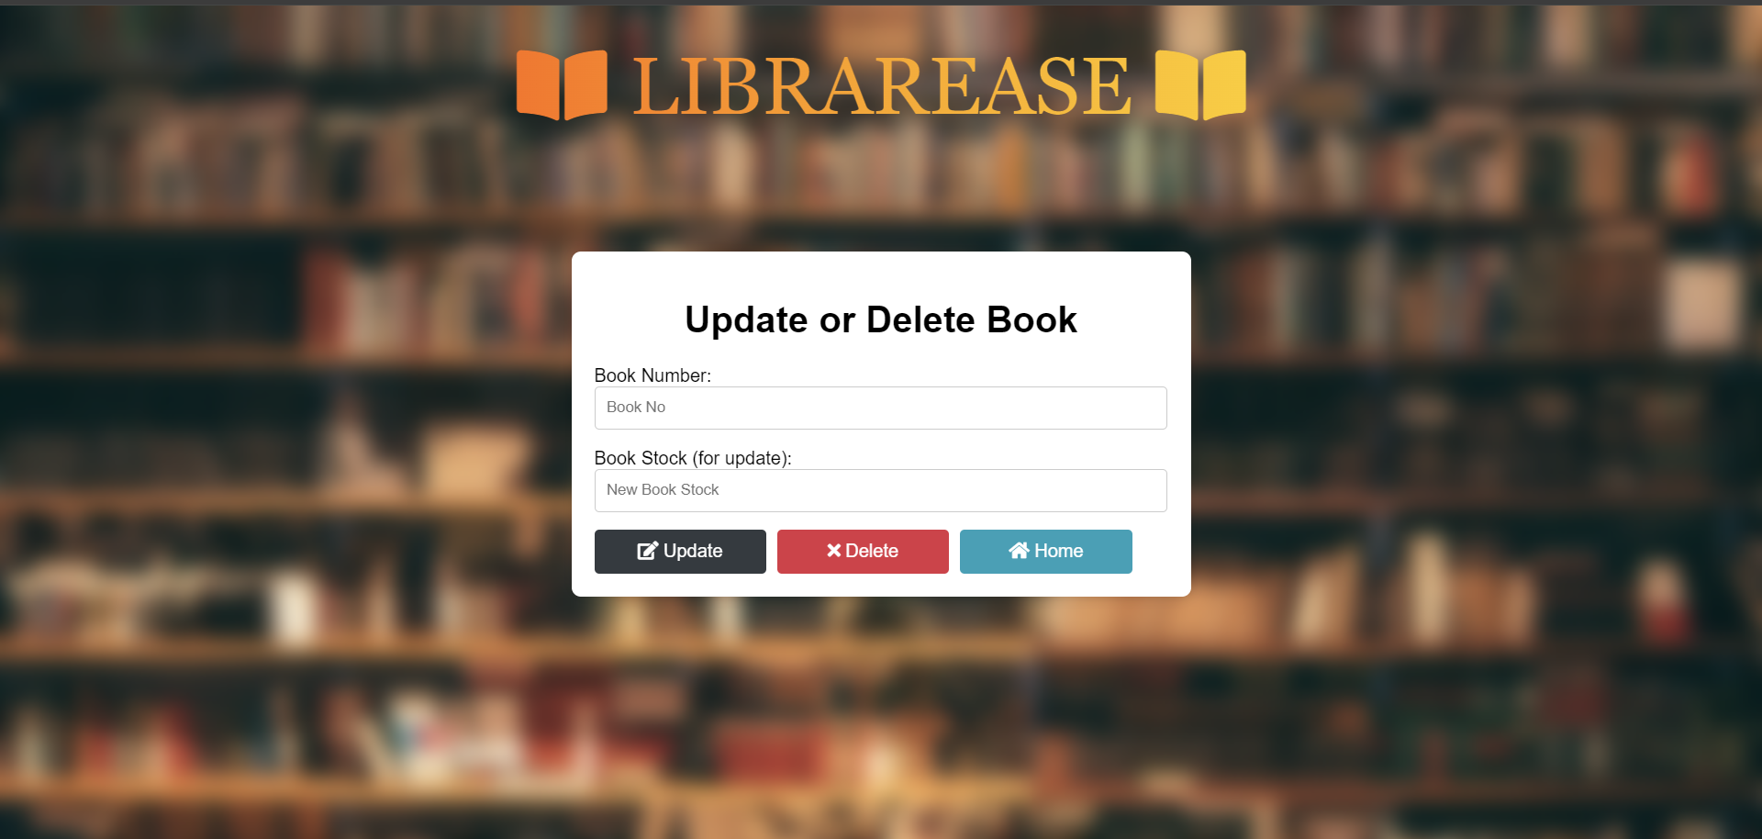

Slide 30
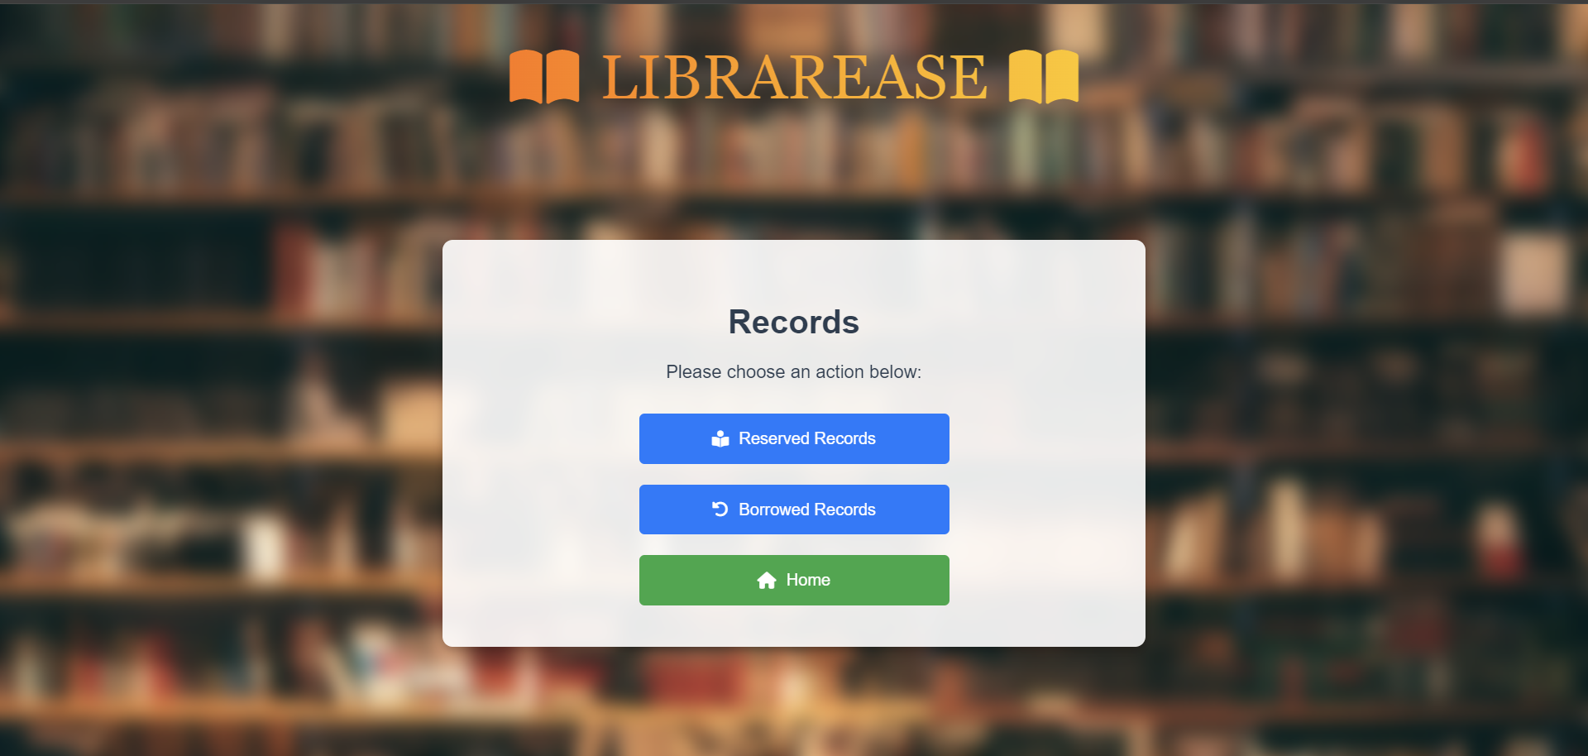

Slide 31
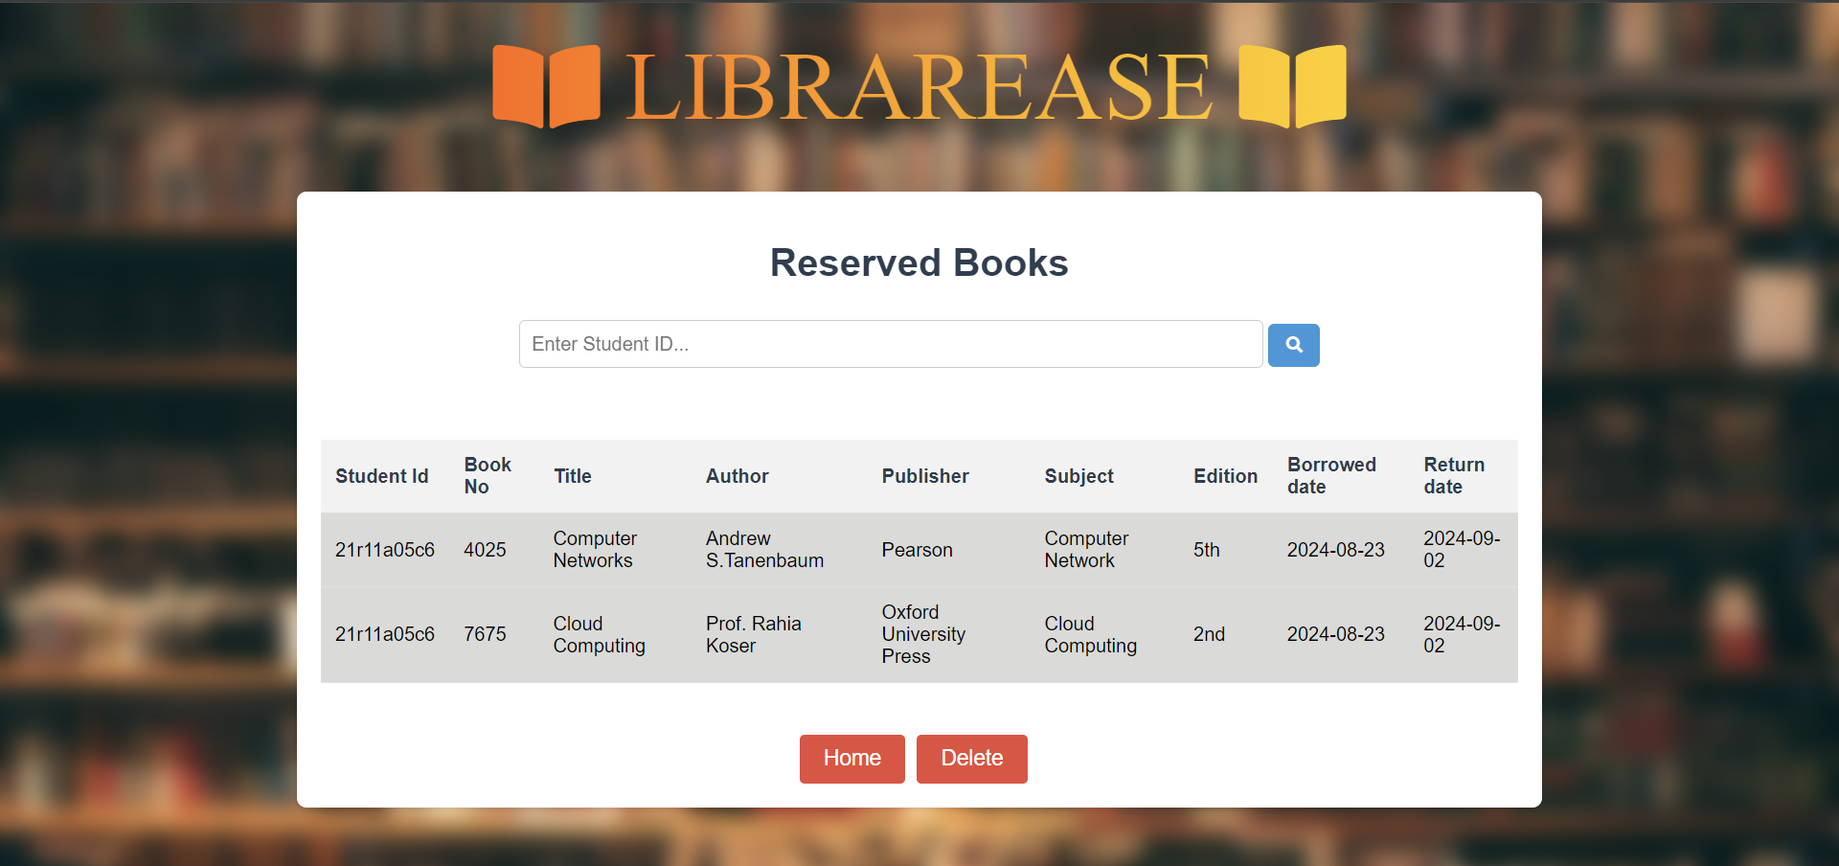

Slide 32
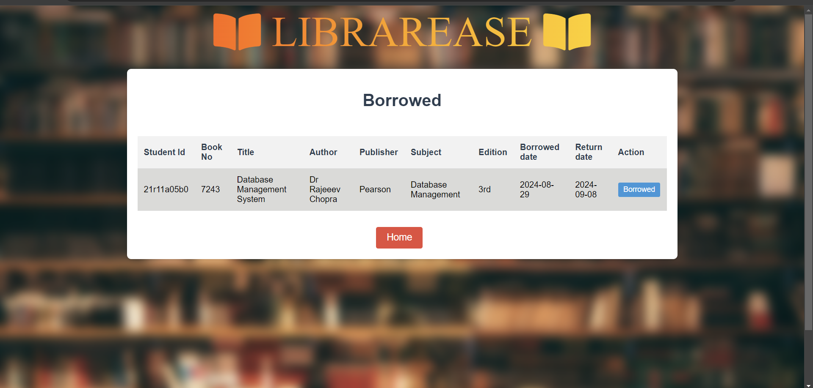

Slide 33
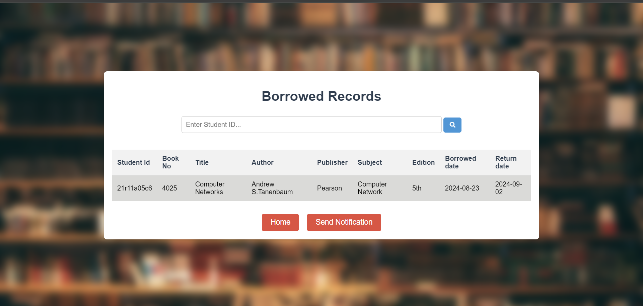

Slide 34
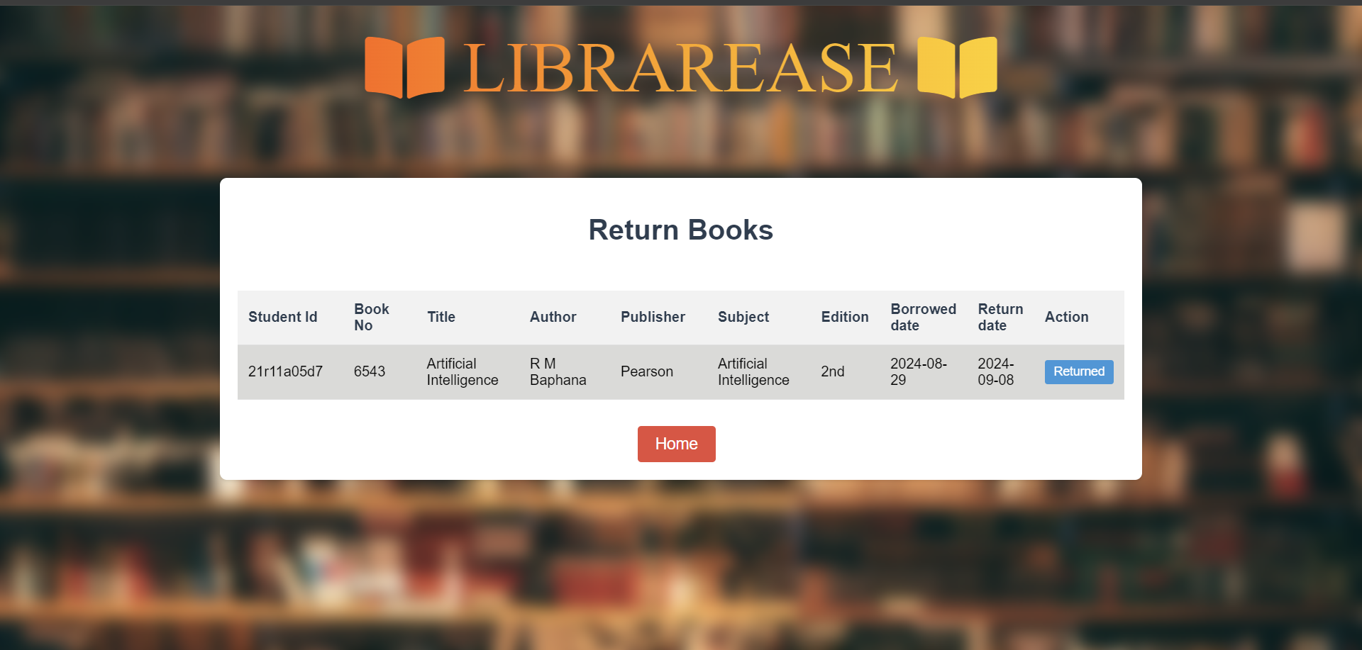

Slide 35


Slide 36
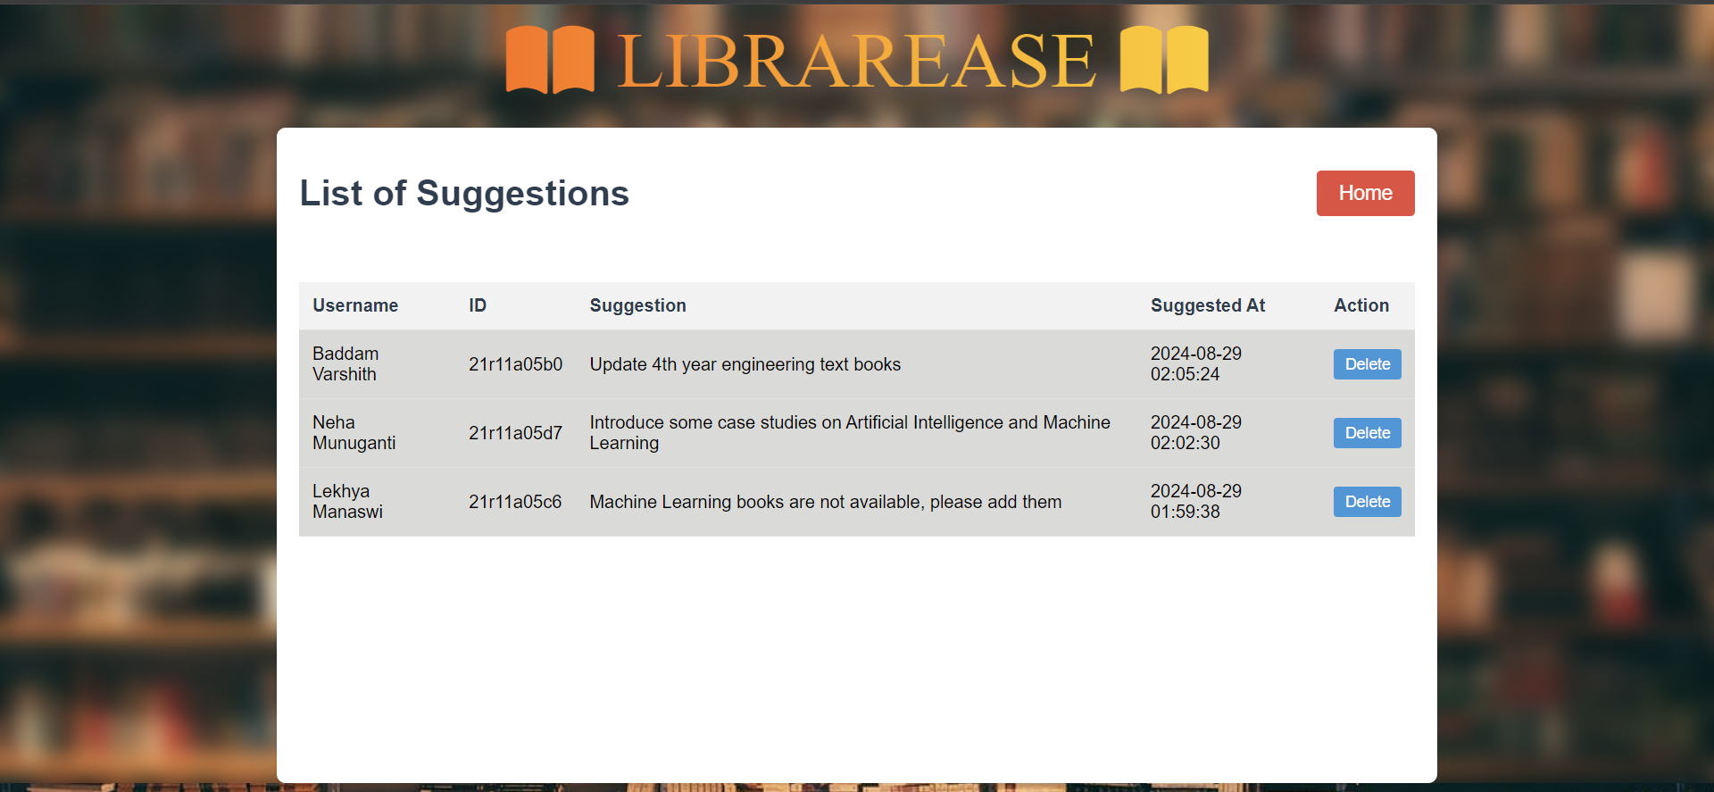

Slide 37
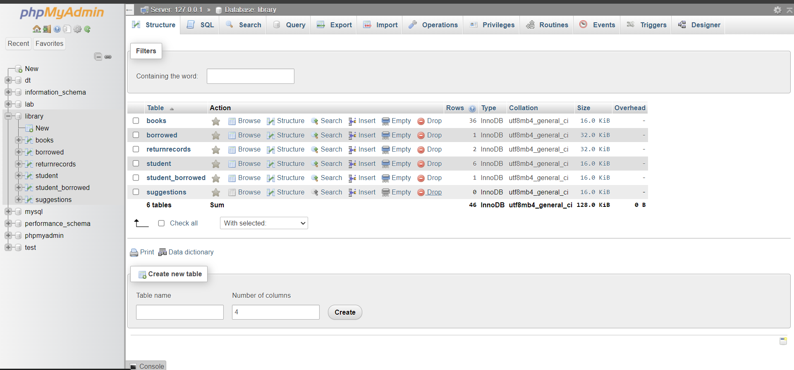

Slide 38
CONCLUSION
LIBRAREASE streamlines library operations with a user-friendly digital interface.
It improves resource management, information retrieval, and communication between students and librarians.
In conclusion, the LIBRAREASE represents a pivotal fusion of traditional library services with modern technological advancements.

Slide 39


Slide 40
Q And A

